Slide 1
Transfer Learning for 3D-Printed Image Classification
VGG16 vs. ResNet50 vs. DenseNet121
Yuval Shaanan & Amit Shraga
Goal: classify images as 3D-Printed or Not 3D-Printed
Question: which pretrained architecture adapts best to this visual task?

Slide 2
Dataset & Experimental Split
What we actually trained on
Original corpus
51,520
images
After filtering
51,488
valid 256×256 RGB images
Training subset
3,000
1,500 per class
80 / 10 / 10 stratified split
Train: 2,400 | Validation: 300 | Test: 300
Test set: exactly 150 3D-Printed + 150 Not 3D-Printed
The full corpus was computationally expensive and we will also see that it was not needed for our task; the balanced 3,000-image subset was used for the comparison.
2

Slide 3
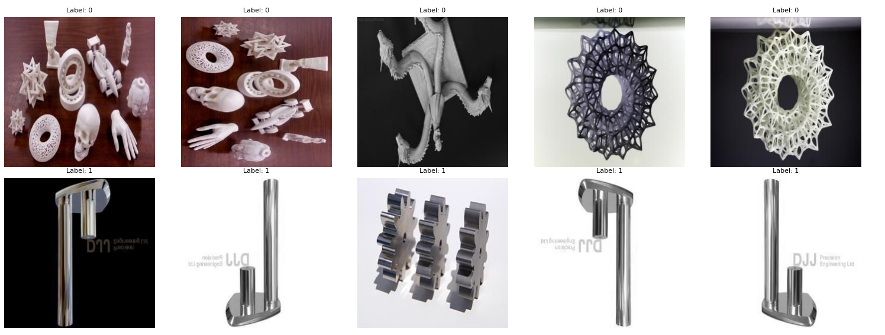
Dataset & Experimental Split
What we actually trained on
3d printed
Not 3d printed
2

Slide 4
Same Training Protocol — Different Backbones
The comparison was designed so architecture was the main difference
Input: 256 × 256 × 3 RGB images | Batch size: 16 | Adam optimizer| Binary cross-entropy
No additional augmentation: The dataset already contained rotated/transformed versions of the images, so further rotation or augmentation was not necessary.
Common head: GlobalAveragePooling2D → Dense(256, ReLU) → Dropout(0.5) → Sigmoid
Stage 1: backbone frozen, learning rate 10⁻³, 3 epochs
Stage 2: upper layers fine-tuned, learning rate 10⁻⁵, 3 epochs
VGG16: top 4 layers unfrozen | ResNet50: top 20 | DenseNet121: top 40
3

Slide 5
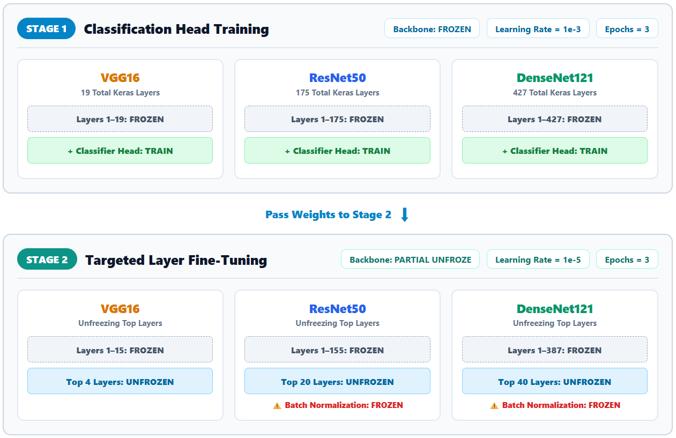
Same Training Protocol — Different Backbones
3

Slide 6
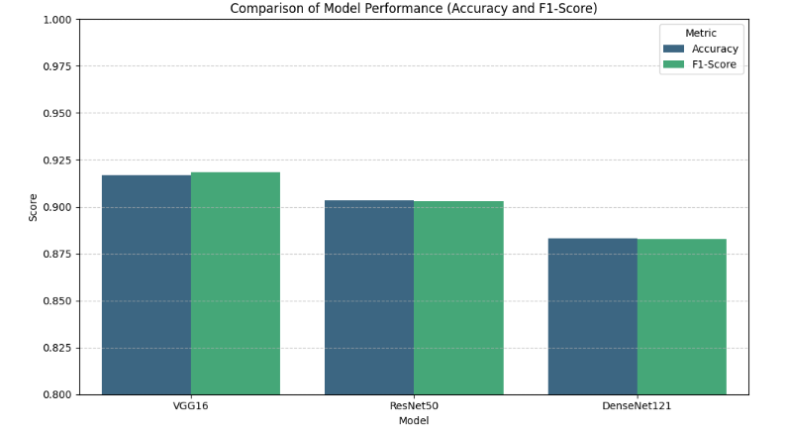
Results: VGG16 Wins — but the Gap Is Small
Held-out test set: 300 images
Model | Accuracy | Precision | Recall | F1
VGG16 | 91.67% | 89.81% | 94.00% | 91.86%
ResNet50 | 90.33% | 90.60% | 90.00% | 90.30%
DenseNet121 | 88.33% | 88.59% | 88.00% | 88.29%
VGG16: 275 / 300 correct
ResNet50: 271 / 300 correct
DenseNet121: 265 / 300 correct
Only 10 correct predictions separate the best and worst models.
4

Slide 7
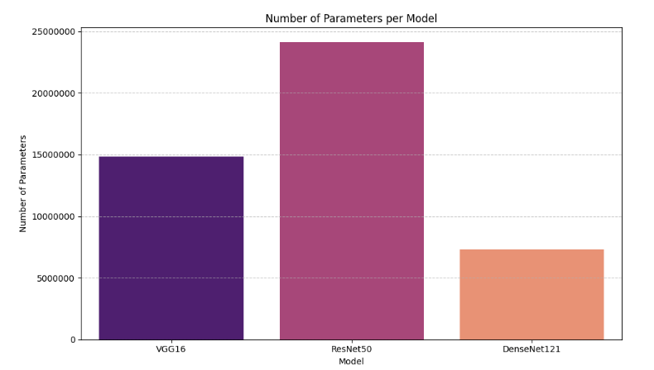
A model's depth does not determine its parameter count
Parameter count does not determine performance

Slide 8
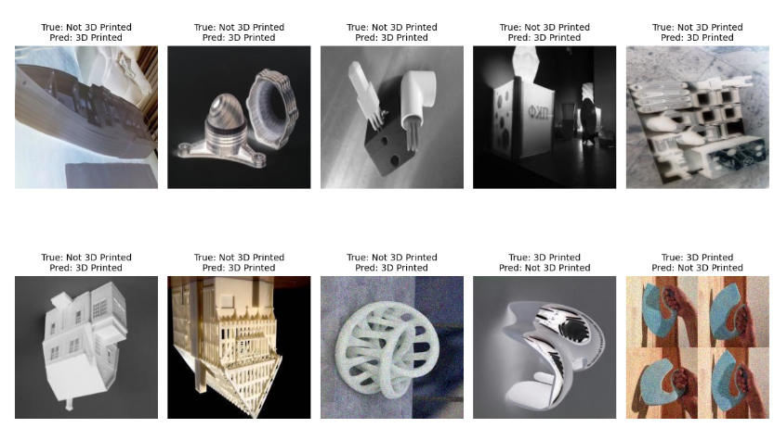
Mispredictions
4

Slide 9
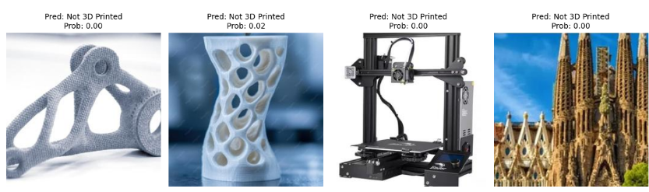
Inference
We took 4 images and inserted them into the VGG model.
2 images were 3d printed (left side) and 2 were not (right side).
The model thought all were NOT 3d printed.

Slide 10
What the Class-Level Results Tell Us
The models do not make exactly the same mistakes
First – all of the models adapted really fast to our dataset, right after the first epoch. Probably, 3d printed images have similar features to many of the classes in ImageNet.
Model size alone is not the explanation: ResNet50 has ~24.1M parameters, yet ranks second.
DenseNet121 has ~7.3M parameters and reaches 88.33% — only 3.34 percentage points below VGG16.
Dense connectivity aggressively reuses and concatenates features; that is powerful, but this task may benefit more from preserving simple local texture patterns.
The task is relatively specific: distinguishing visual evidence of 3D printing rather than recognizing broad object categories.
Most importantly: with only 300 test images, the ranking is indicative, not statistically definitive. We’ve tried on larger numbers and got similar results.
5

Slide 11
ImageNet Helps — but It Is Not the Same Domain
Why transfer learning still makes sense
ImageNet pretraining gives the networks a useful starting point for edges, shapes, textures and other generic visual patterns.
But ImageNet is dominated by everyday natural objects; it was not designed around 3D-printing cues, yet we did manage to execute transfer learning with few images and few training epochs.
Result: all three models exceeded 88% accuracy despite the domain difference.
Bottom line: transfer learning works well for this task
7

